Slide 1
Building Your Future with Mountain Peak Homes
Corinne T. Moritz

Slide 2
See Yourself in One of Our Homes

Slide 3
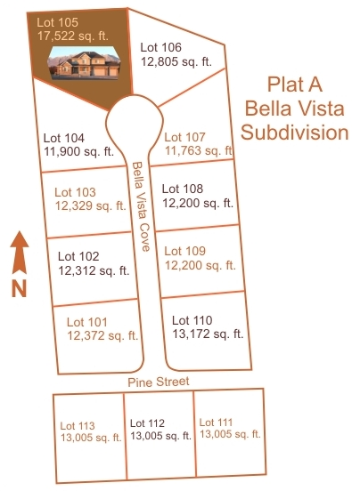
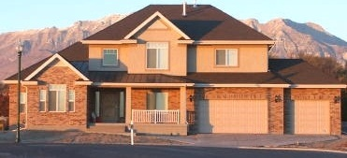
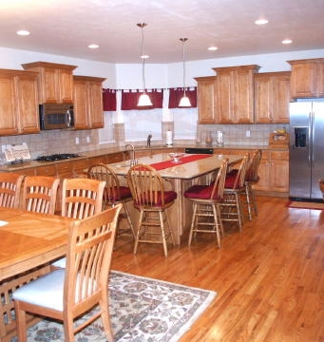
Bella Vista Subdivision
Model Home
Prices for lots range from
$250,000 to $325,000

Slide 4
Selecting a Home Design
Assess your needs
Assess your price range
Look in Catalog of Homes
Find a home in your price range
Visit a model home

Slide 5
The Purchasing Process
Select a lot
Select a home design
Put $12,000 down to hold lot
Secure financing
Customize house plans
Hold pre-construction meeting
Put down 10% of home (plus lot)
Hold pre-dig meeting
Hold four-way walk-through
Hold final walk-through
Close on house

Slide 6
Building Phase 1
Dig hole
Pour footings and foundation
Do framing
Install windows and outer doors
Pour driveway, sidewalk, porch cement

Slide 7
Building Phase 2
Rough-in HVAC
Rough-in plumbing
Rough-in electrical
Install roofing

Slide 8
Building Phase 3
Install drywall, tape, mud
Install railings and banisters
Install moldings and casings
Install cabinets, countertops, sinks

Slide 9
Building Phase 4
Install soffit, gutters, drains
Finish exterior brick, stucco, and/or stone
Install inner doors
Finish work on HVAC, plumbing, electrical
Install flooring
Paint and varnish
Install lighting

Slide 10
Before You Close on Your Home
Make sure you have all your financing in order.
Carefully check everything during the four-way walkthrough and the final walkthrough.
Hire an independent home inspector.
Make sure you understand the Mountain Peak Homes warranty.

Slide 11
For More Information
Contact:
Corinne T. Moritz
Mountain Peak Homes
8828 West Rimrock Road
Billings, MT 59107
Office 406-555-8828
Cell 406-555-1739
www.mountainpeakhomes.com

